Slide 1
Module 8.1 - Robot Localization
Introduction to Robot Localization

Slide 2
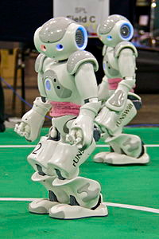
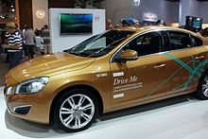
Robot Localization
Localization is knowing a robot’s position and orientation in the world around it.
Notes:
Localization is the task of knowing a robot’s position in the world around it
For the soccer robot shown above, it is know where on the field the robot is and which direction it is facing
For the car on the right, localization can occur on different scales
Using GPS, the car could know where it is in the city it is driving in
Using a camera, the car could localize within the lane it is driving in

Slide 3
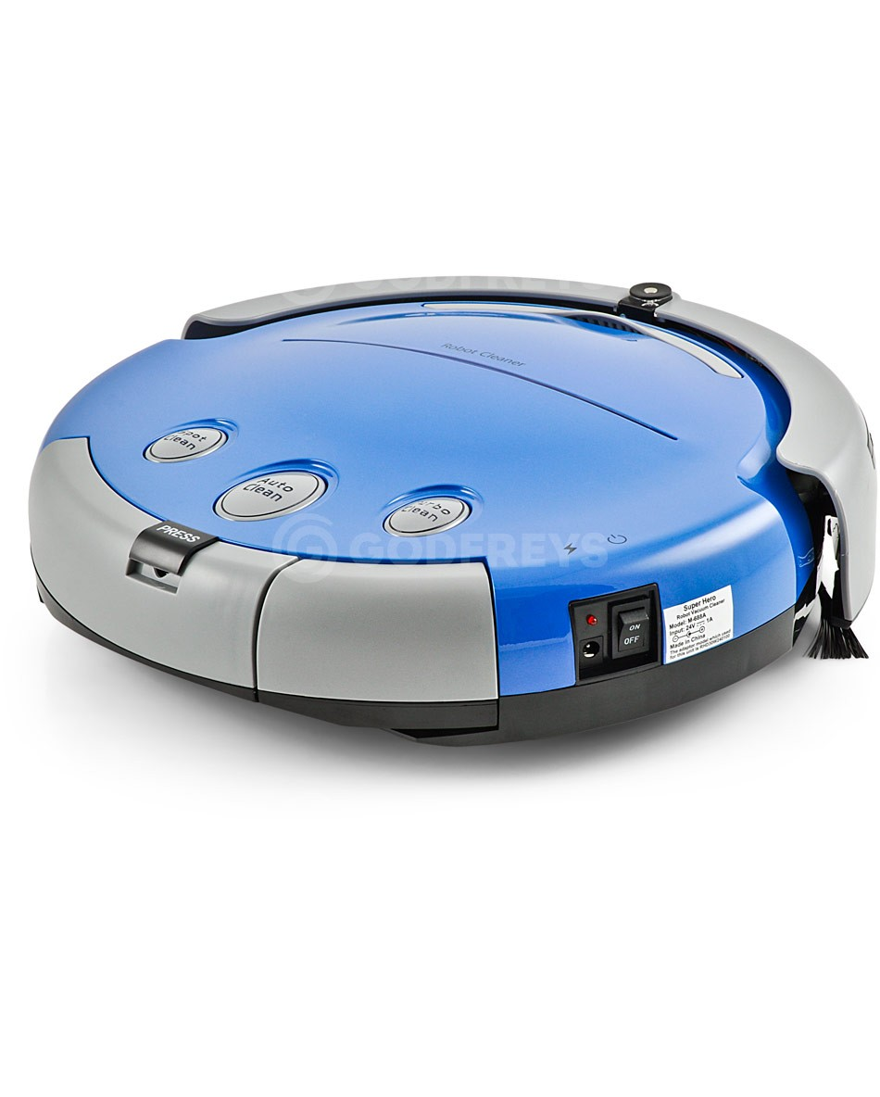
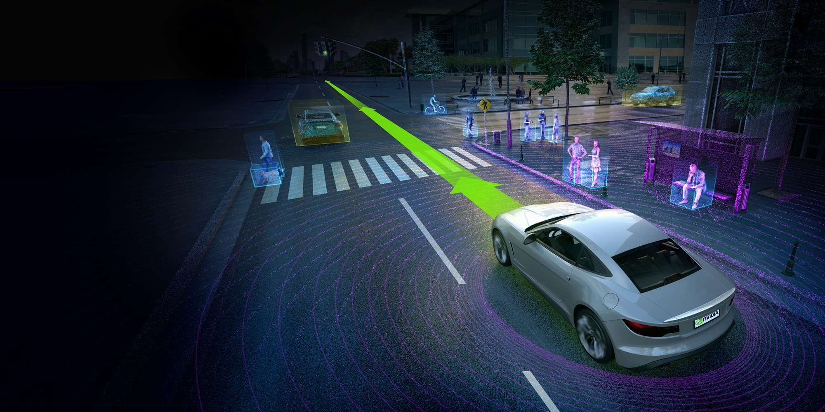
Applications of Localization
Precision driving
Room to room navigation
Notes:
Robot vacuum cleaners need to localize in order to know if they have covered a particular room or area of a room
In a self-driving car scenario, the car needs to localizes itself in relation to the road and intersections

Slide 4
Localization and Mapping
Localization is the task of determining a robot position
Mapping is the task of building an accurate map of the environment
Simultaneous Localization and Mapping (SLAM)
A process of dynamically building a map of the world around a robot while estimating the position of the robot within this map
Notes:
Localization is the task of determine a robot’s position
Mapping, which is covered in Module 9, is the task of building an accurate map of the environment
The localization task assumes that a pre-existing map is known and that map can be referenced during the localization process
Simultaneous Localization and Mapping (SLAM) is the process of building a map while localizing the robot within the map
This is a process that humans are very adept to. For example a person can visit a new building and after traverse the hallways a few times, the person becomes familiar with the layout of the building and knows where they are in the building.

Slide 5
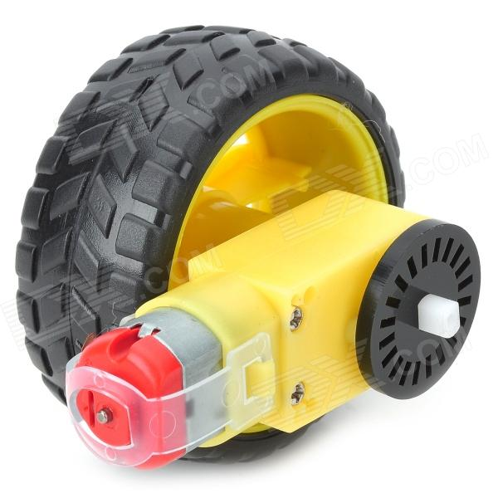
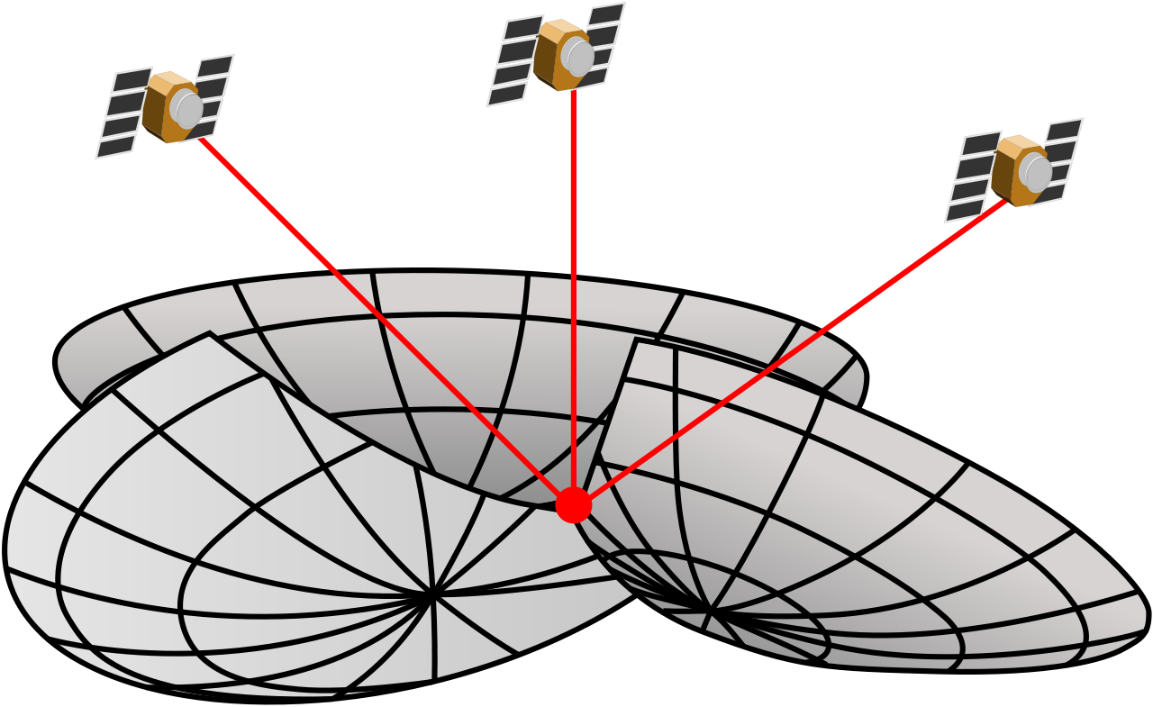
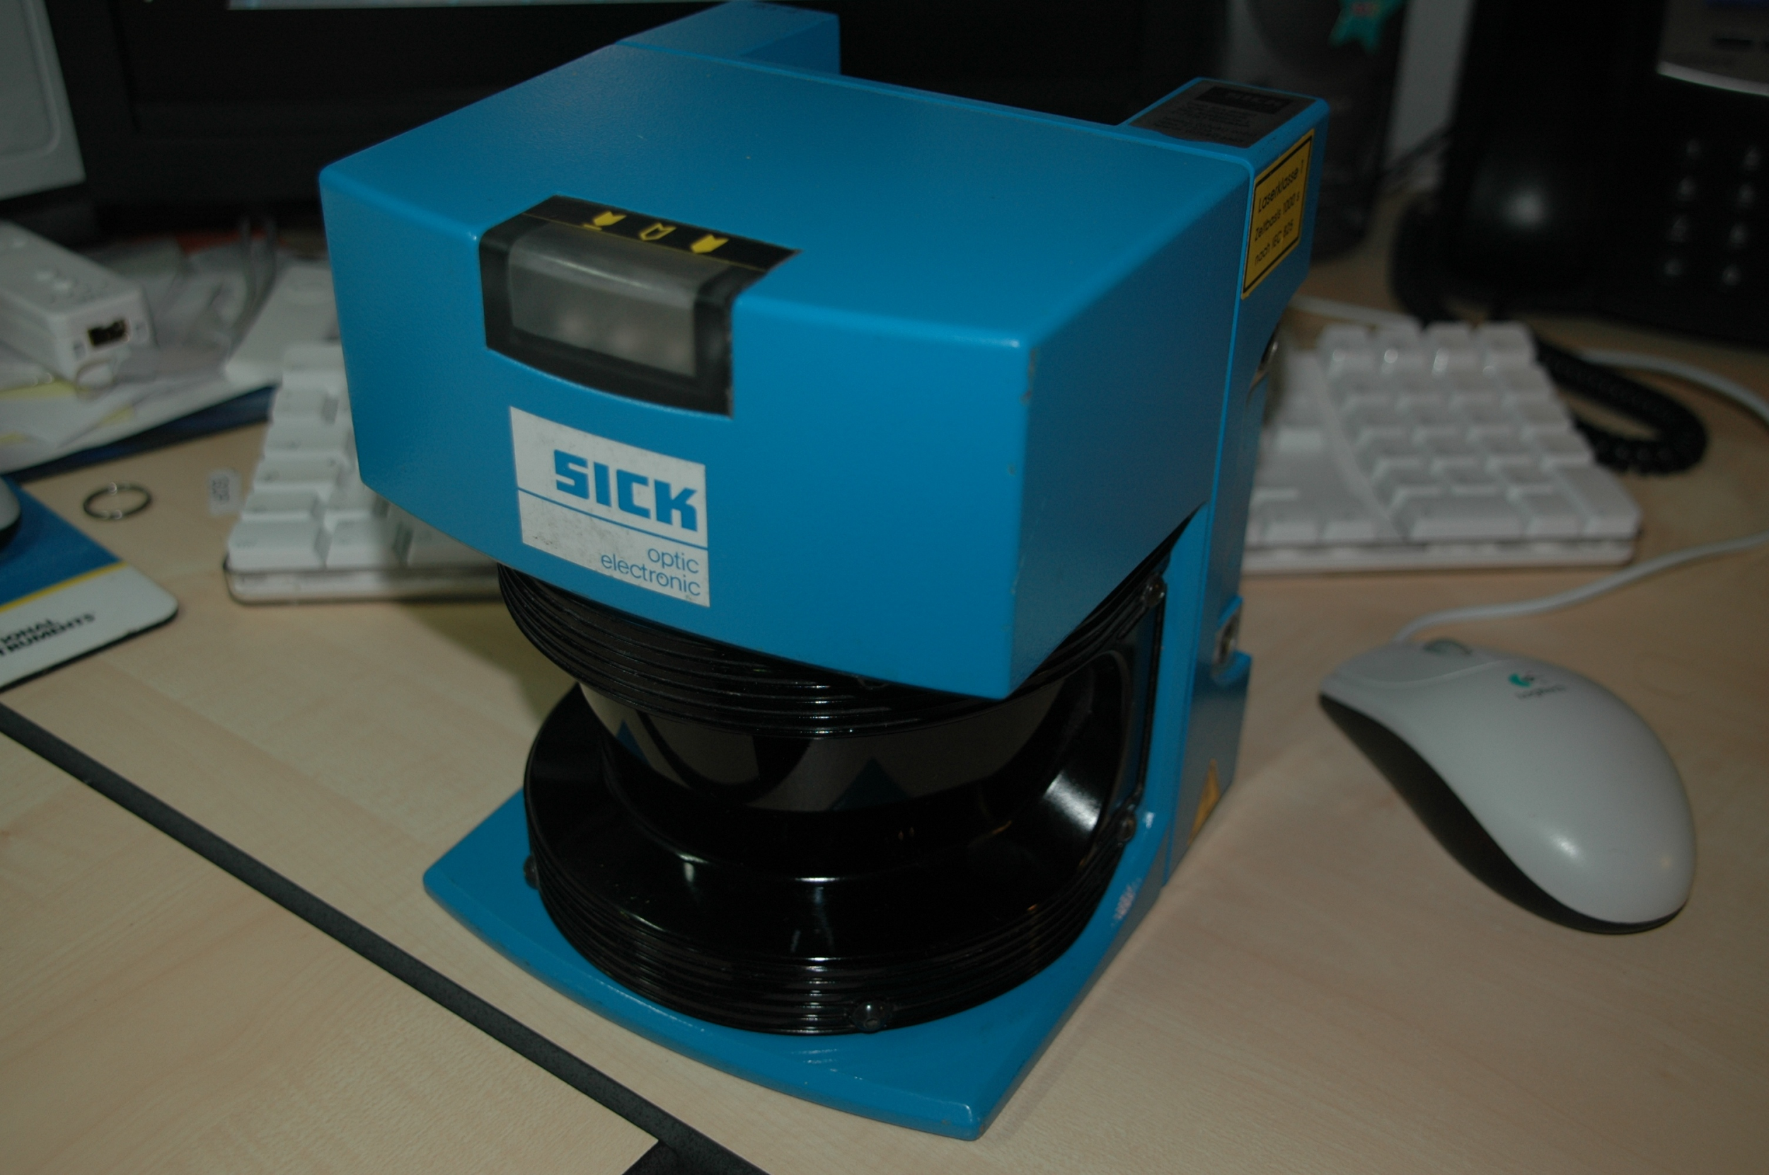
Localization and Sensors
Sensors on the robot
Encoders
Gyroscope
Accelerometer
Compass
Active Sensors
Sonar
Laser
Radar
Camera
Radio
GPS, Wi-fi
Notes:
There are various sensors that can be used during the localization process
These sensors fall into 2 categories: sensors that are on the robot and do not require any external information and those sensor which do require external sensing information
Sensors on the robot include wheel encoders, gyroscope, accelerometer, and compass
Given the noise present in many of these sensors, it is necessary to incorporate sensor readings of the world around a robot
Active sensors include sonar, laser scanner, radar, cameras, and various radio techniques such as GPS and Wi-fi

Slide 6
Uncertainty in Localization
The problem with using only odometry or motion sensors is that as the robot moves, there is noise in the motion
Wheels can slip on the ground
Wheel encoders have a finite amount of precision
Accumulated gyroscope readings can drift over time
Sensors that provide readings of the surround environment also contribute to localization uncertainty
Because of these reasons, localization often cannot be exact
Notes:
Localization with odometry alone cannot provide a good estimate of the robot’s position over time
Odometry using wheels encoders will drift over time. Wheels can slip on the ground and additionally, wheel encoders provide only a finite resolution. The error in this finite resolution is compound over time as the robot moves around.
Gyro readings can drift over time as well.
Active sensors that provide information about the world also have inherent noise. A sensor reading of a particular environment may be different from one instance to the next just because of sensor noise
Because of these reasons, localization often cannot be exact and localization algorithms provide the best possible estimate of a robot location.

Slide 7
The GPU Teaching Kit is licensed by NVIDIA and California Polytechnic State University under the Creative Commons Attribution-NonCommercial 4.0 International License.

